Slide 1
Bank Customer Churn Analysis Group 2
Dominik Foale
Anrie Santos
Bilal Rasheed
Husna Nasution

Slide 2
Project Description
Our project intends to determine the key drivers that cause customer churn from bank institutions (Churn referring to customers leaving a given bank for a competitor service).
Analysis goal:
1. How do factors such as tenure (number of years customer has been with bank), customer bank account balance, salary, credit score etc affect churn rate?
2. How can we predict churn rate based on these factors?

Slide 3
Datasource
https://www.kaggle.com/datasets/radheshyamkollipara/bank-customer-churn?resource=download
The data included features like Credit Score, Geography, Gender, Age, Tenure, Balance, Estimated Salary, Card Type, Complain

Slide 4
Data Preprocessing
- Dropped columns/features: RowNumber, CustomerID, Surname & Geography
- Binning applied to: CreditScore, EstimatedSalary, Balance & Age

Slide 5
Result and Analysis

Slide 6
Model:
TensorFlow
Hidden Layer 1: 9 Nodes, RELU Activation
Hidden Layer 2: 19 Nodes, RELU Activation
Sigmoid Output Layer
100 Epochs
99.64% Accurate, 0.06 Loss

Slide 7
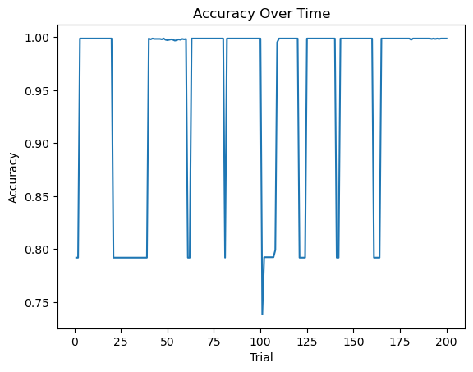
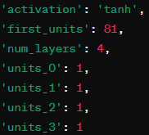
Model:
Keras Tuner
Hyperparameter Tuning library for TensorFlow
10 Runs @ 20 Epochs each
Best Performing Model:
99.88% Accurate

Slide 8

Model:
SVC
Support Vector Classifier
Commonly used for binary classification
Uses hyperplane to separate classes in feature space
Resistant to overfitting
99.72% Accurate

Slide 9

Model:
XGBoost
Gradient Boosting Machine
Boosting algorithms combine multiple weak learning models sequentially
Effective at binary classification
Able to determine feature importance
99.90% Accurate

Slide 10
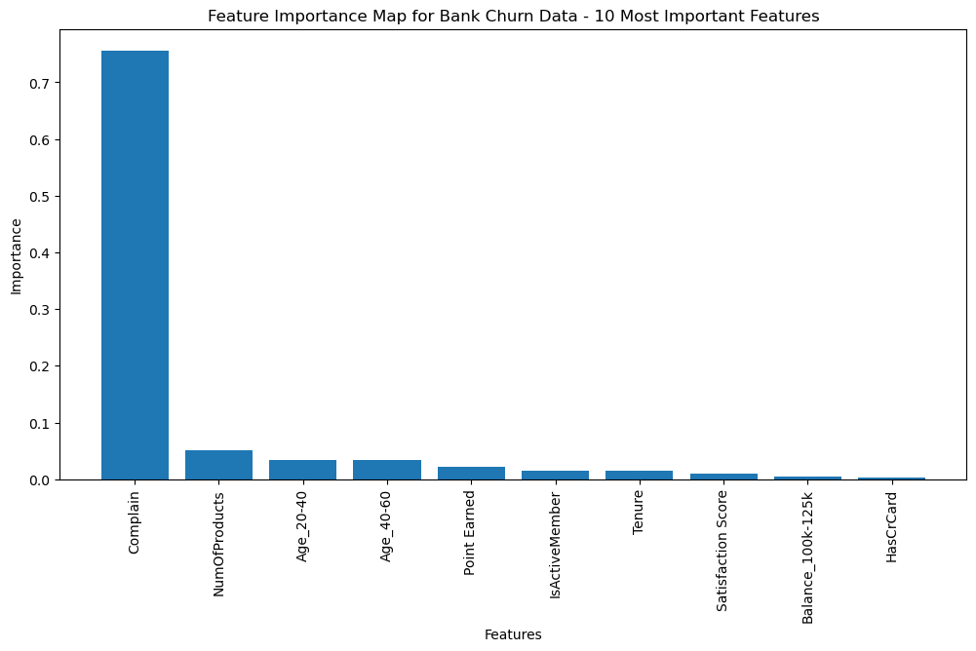
TensorFlow
Feature Importance

Slide 11
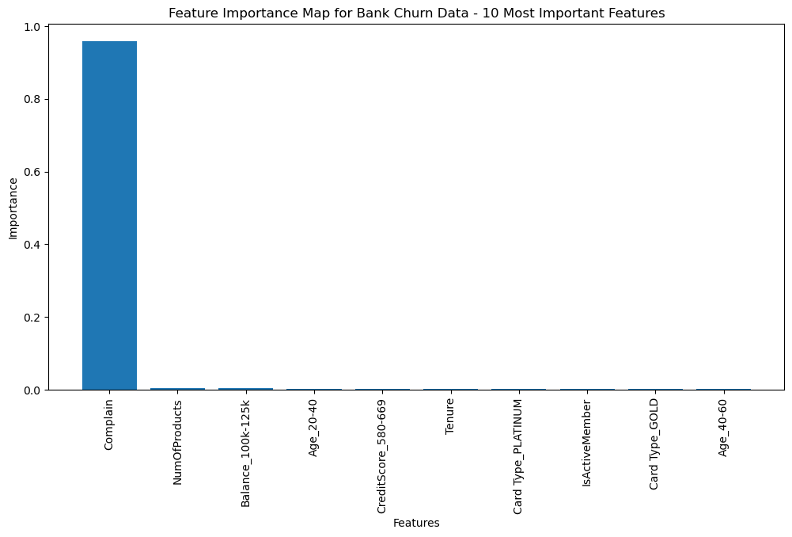
XGBoost
Feature Importance

Slide 12
Conclusions
Complaint factor/feature was the most impactful determinant of customer churn
XGBoost Accuracy: 99.90%
Keras Tuner Neural Network Accuracy: 99.88%
Support Vector Classifier: 99.72%

Slide 13
Thank You
Group 2

